Slide 1
M.P.NACHIMUTHU M.JAGANATHAN ENGINNERING COLLEGE
CHENNIMALAI, ERODE – 638 112.
IOT BASED SAFETY GADGET FOR CHILD SAFETY AND MONITORING AND NOTIFICATION
TEAM ID : PNT2022TMID44574
Presented by,
731719106008 | MATHIVAANAN.A
731719106003 | BARATHAN.D
731719106006 | GEETHA.P
731719106010 | NAGARAJ.K

Slide 2
AREA OF THE PROJECT
INTERNET OF THINGS(IOT)
2

Slide 3
OBJECTIVES
Enables tracking of the child’s location and capturing of data remotely such as where the child located,distance,etc.
To show the child’s actual data with reference values.
Enables sending of notification if the child is out of location or when the device realizes abnormal conditions/situations.
Develop a prototype of IoT wearable smart band connected to parent’s mobile apps so that they can monitor the actual condition of children at anytime and anyplace.
2

Slide 4
LITERATURE SURVEY
Author | Title | Proposed Methods | Journal, Year
David Hanes, Gonzalo, Patrick Grosetete, Robert, Barton, Jerome. | “IoT Fundamental and Networking Technologies, Protocols” | During an emergency, mobile apps alert the control room of nearby police stations or caretakers of children. The literature shows that location tracking devices are available in the market but it does not provide a complete solution to the problem. The solution to this problem is to design an IoT device, which senses the child’s location and environment and during an emergency, it should send the alert to the parents automatically. | Cisco,2017
Aditi Gupta, V i b h o r Harit. | C h i l d S a f e t y & T r a c k i n g M a n a g e m e n t System by using GPS. | This paper proposed a model for child safety through smartphones that provide the option to track the location of their children as well as in case of emergency children are able to send a quick message and its current location via Short Message Services. Merits: The advantages of smart phones they offer rich features like Google maps, GPS, SMS etc. Demerits: This system is unable to sense the human behaviour of children. | IEEE,2016
K. N. H. Srinivas, T. D. S. Sarveswara Rao, E. Kusuma Kumari. | Smart IoT Device for Child Safety and Tracking. | The system is developed using Link-It ONE board programmed in embedded C and interfaced with temperature, heartbeat, touch sensors and also GPS, GSM & digital camera modules. The novelty of the work is that the system automatically alerts the parent/caretaker by sending SMS when immediate attention is required for the child during an emergency. | IEEE,2019 4

Slide 5
METHODOLOGY
It focuses on the key aspect that a missing child can be assisted by
the people around the child and can play a remarkable role in the child’s safety until reunited with the parents.
If any deviant readings are disclosed by the sensor, then an SMS and phone calls are set off to the parent's mobile. Also, it overhauls the parental app through the cloud.
The technique is equipped with GSM and GPS modules for sending and receiving calls, and SMS between the safety gadget and the parental phones.

Slide 6
The system also consists of a Wi-Fi/cellular data module used to implement IoT and send all the monitored parameters to the cloud for android app monitoring on the parental phones.
The panic alert system is used during panic situations alerts are sent to the parental phone, seeking help also the alert parameters are updated to the cloud. Most of the wearables available today are focused on providing the location, and activity of the child to the
parents.

Slide 7
METHODOLOGY
HARDWARE REQUIREMENTS:
IoT device GSM
Mobile(Notification) GPS
SOFTWARE REQUIREMENTS:
IBM Cloud
IBM IoT Platform IBM Node red IBM Cloudant DB

Slide 8
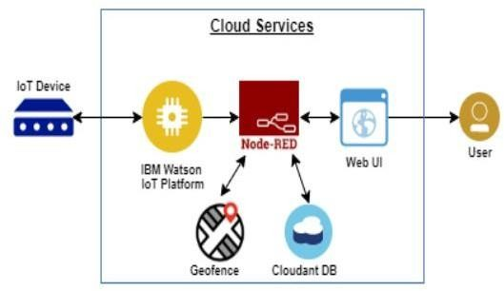
PROPOSED BLOCK DIAGRAM/ TECHNICAL ARCHITECTURE

Slide 9
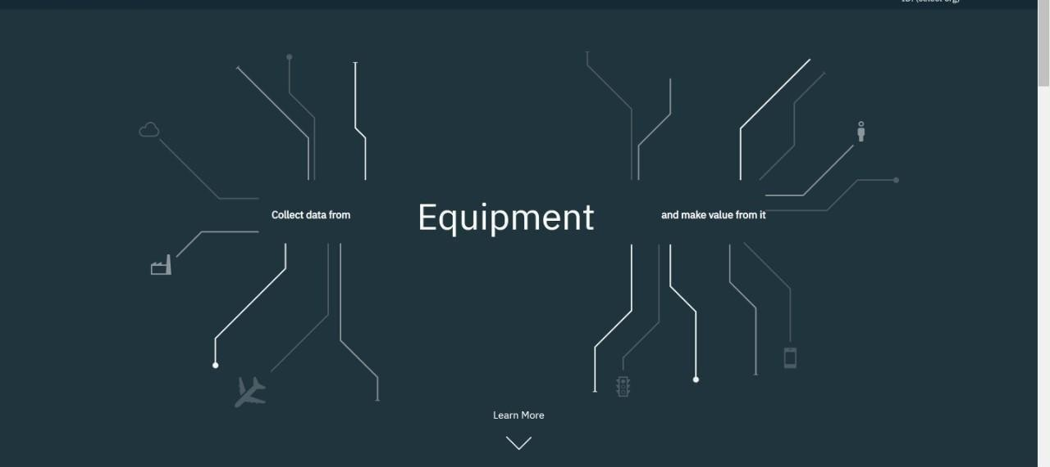
SIMULATION AND RESULTS
IBM WATSON IOT PLATFORM
Fig.1,Creating IBM Cloud Service and creating the device

Slide 10
Creating Python Code:
import json
import wiotp.sdk.device import time
import random myConfig = {
"identity":{"orgId": "4o1qxb", "typeId": " NodeMCU",
"deviceId": "502645"},
"auth": {"token":" F1eqrGOoNLaTFjk?Sz”} } client = wiotp.sdk.device.DeviceClient (config=myConfig, logHandlers=None) client.connect()
while True:
name "Smartbridge"#in area location latitude= 10.7357099
longitude= 79.10207
#out area location #latitude= 10.7357099
#longitude=79.10207 myData={'name': name,'lat':latitude, 'lon' :longitude} client.publishEvent(eventId="status", msgFormat="json", data=myData, qos=0, onPublish=None)
print("Data Published to IBM IoT platfrom: ", myData) time.sleep(5)
client.disconnect()

Slide 11
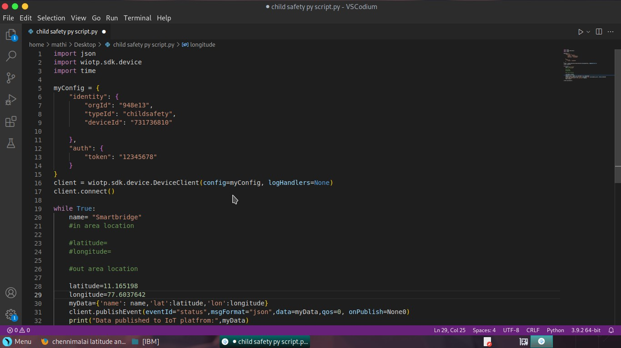
Fig.2,In-Area Location

Slide 12
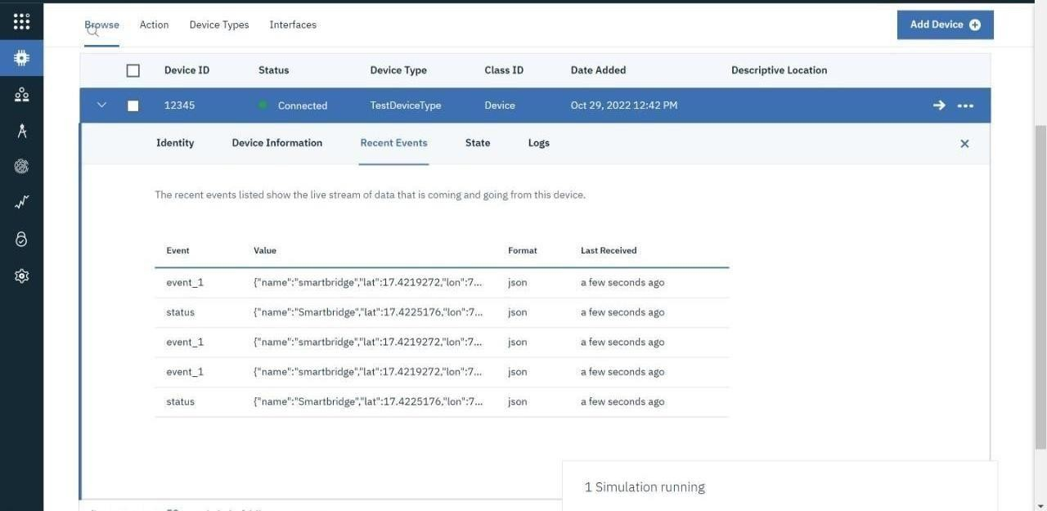

Slide 13
Fig.3, Out-Area Location

Slide 14
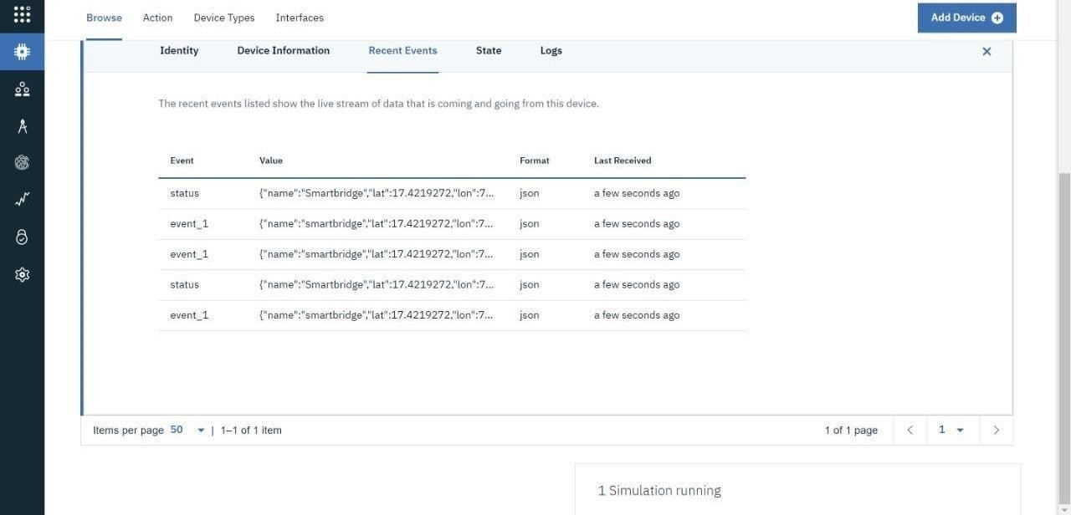

Slide 15
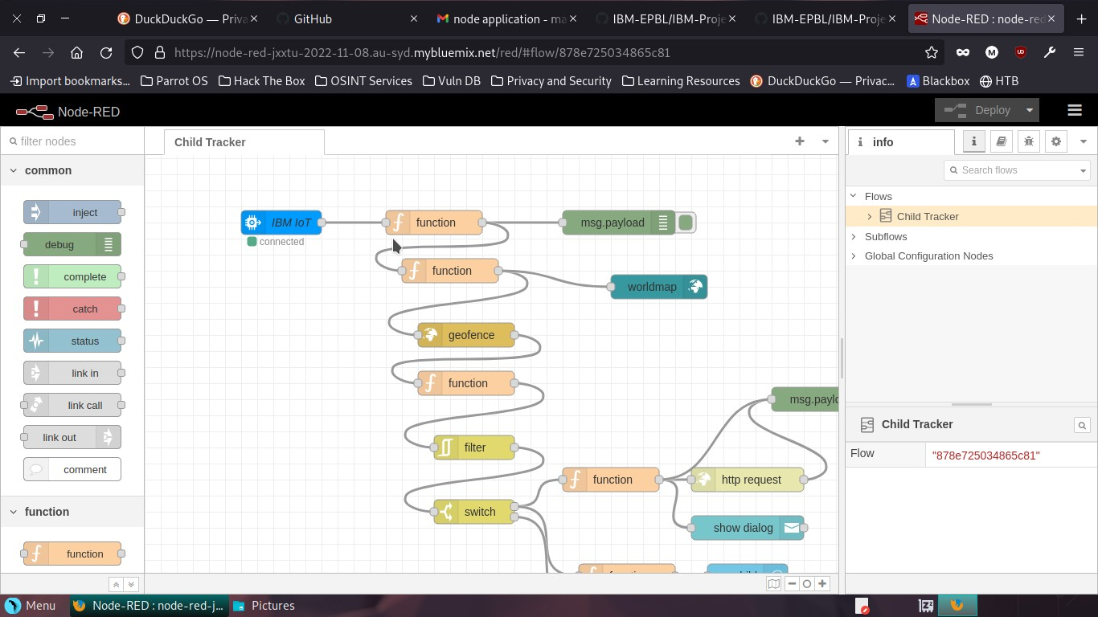
NODE-RED SERVICE
Fig.4,Create Node red service

Slide 16
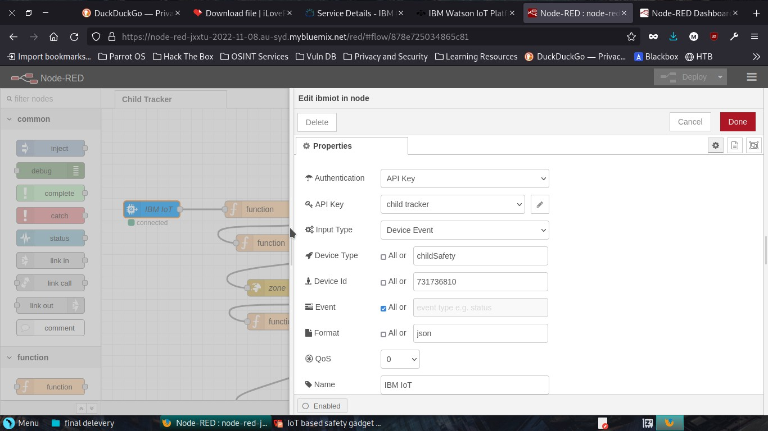
Fig.5,Code in each nodes

Slide 17
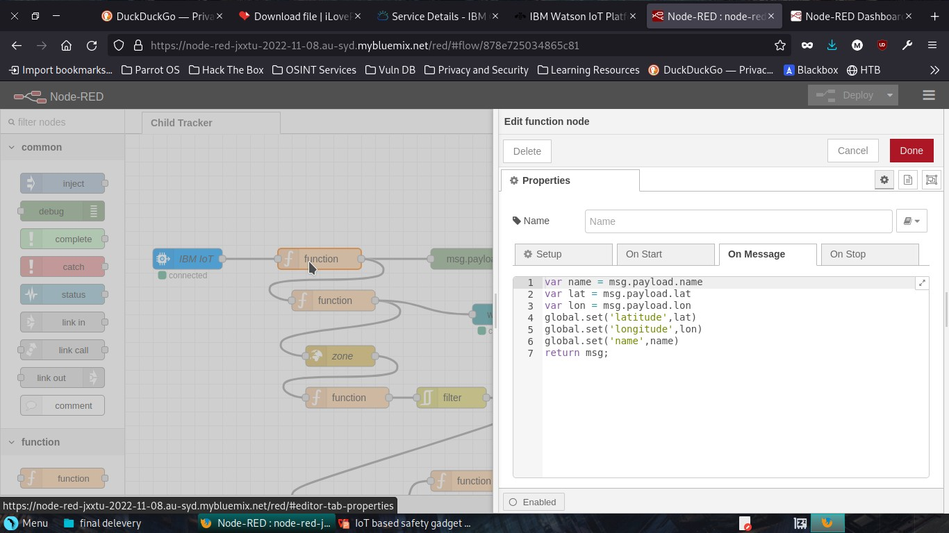

Slide 18
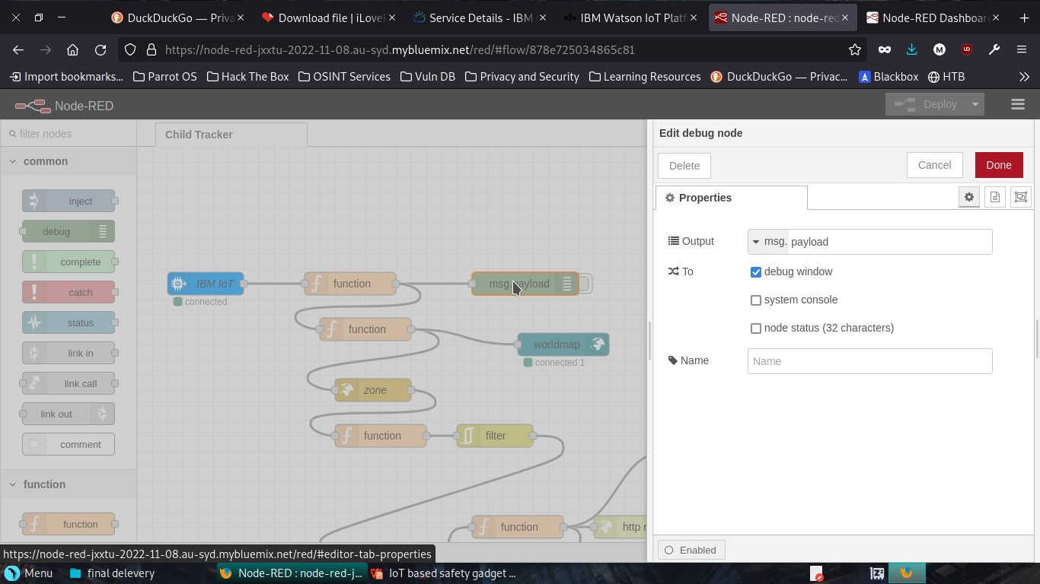

Slide 19
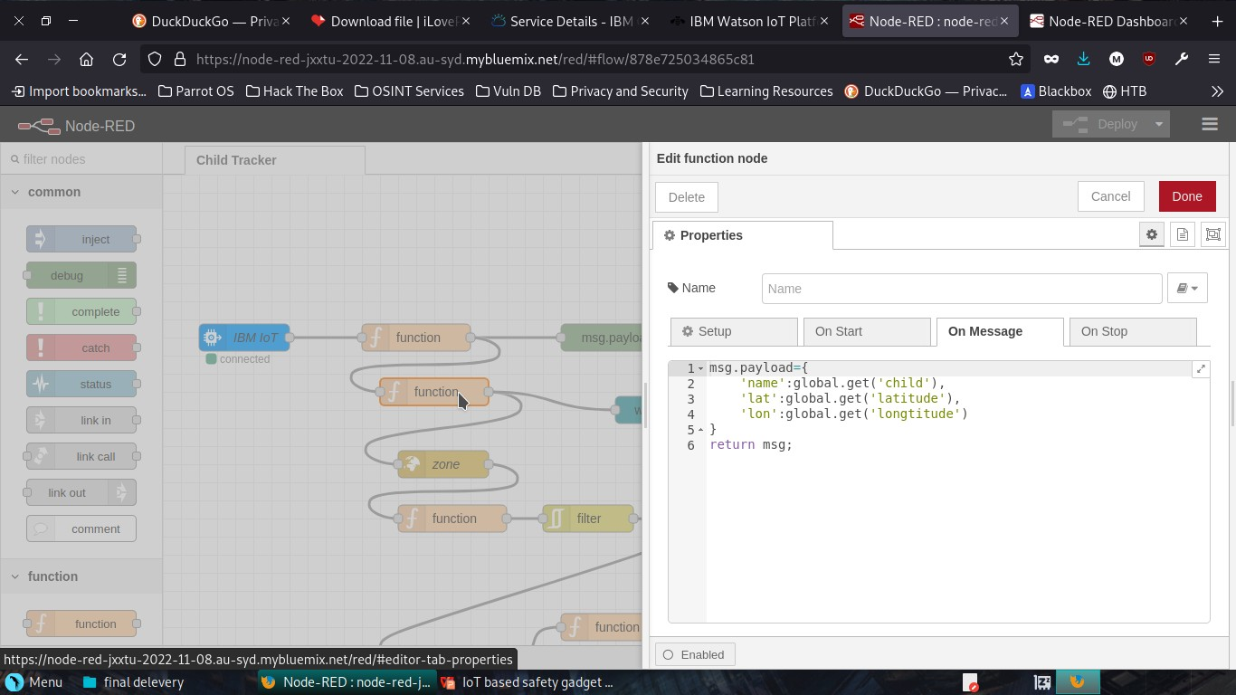

Slide 20
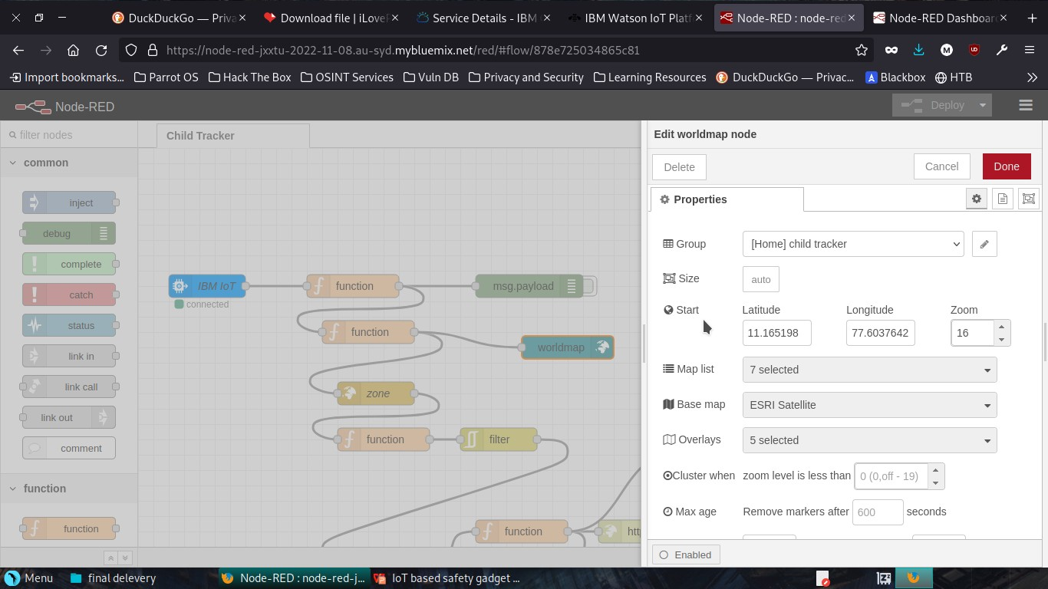

Slide 21
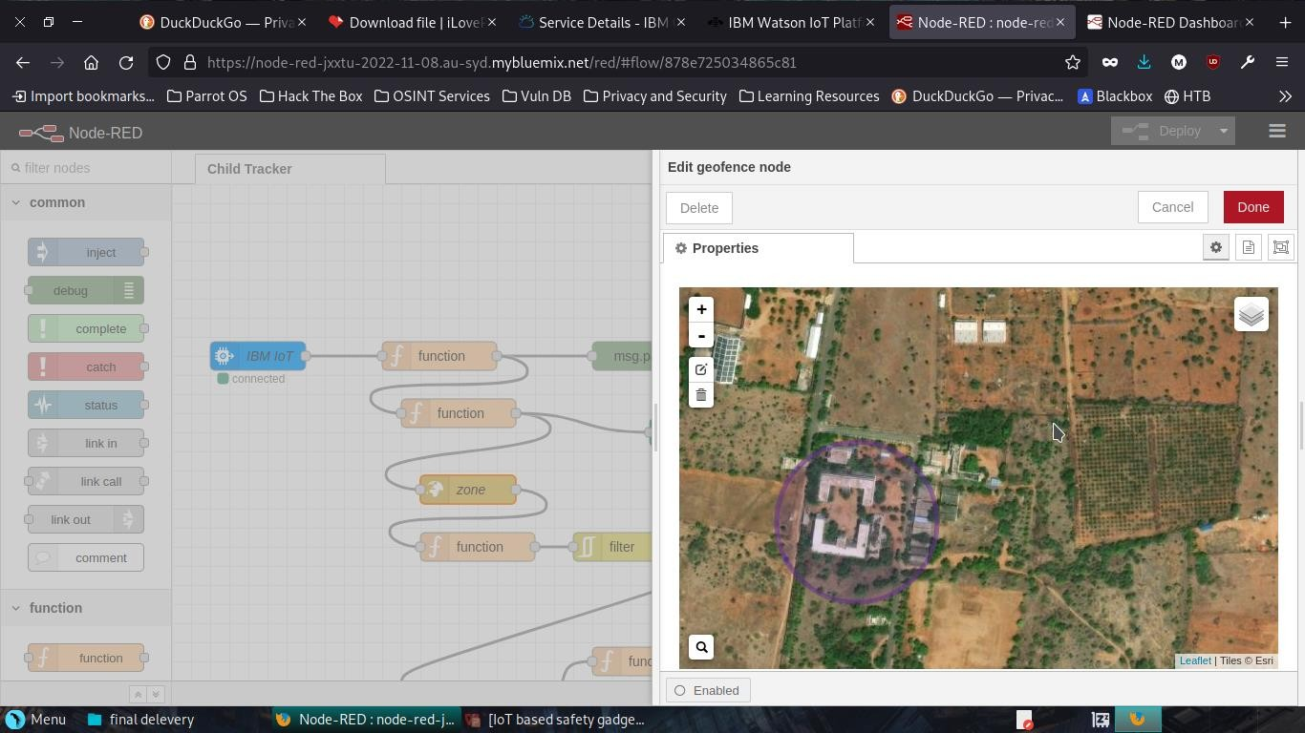

Slide 22
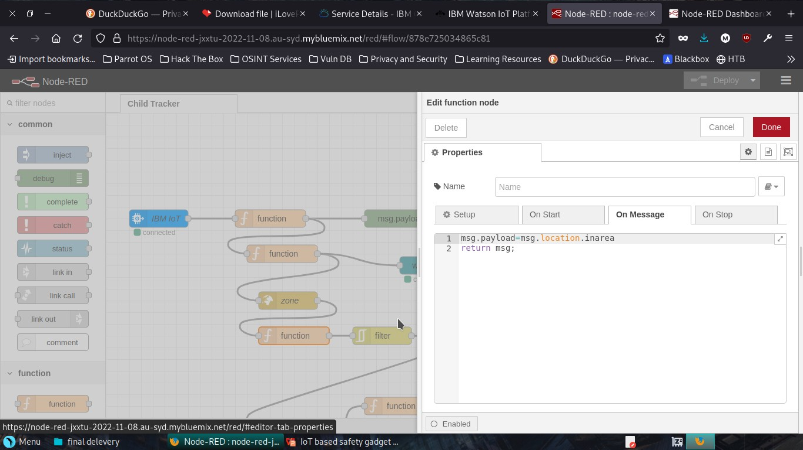

Slide 23
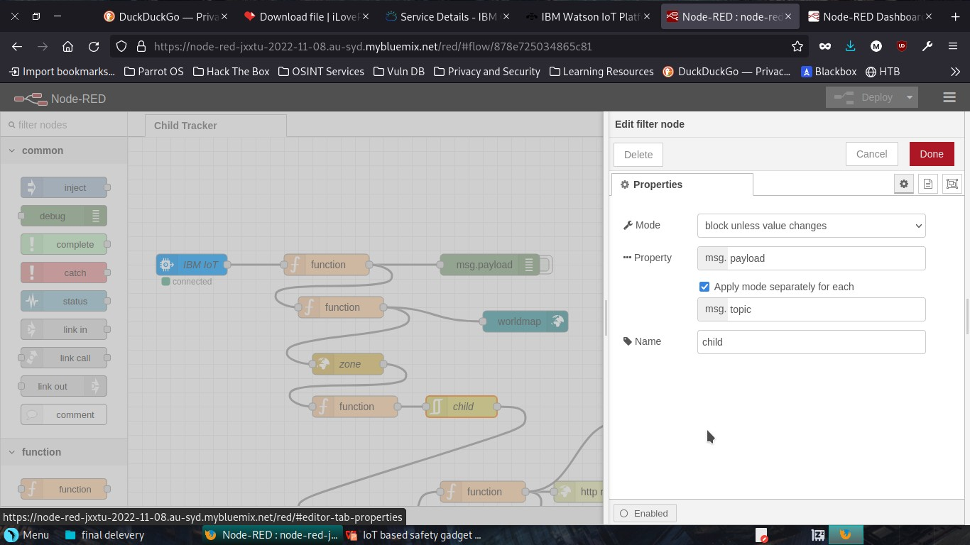

Slide 24
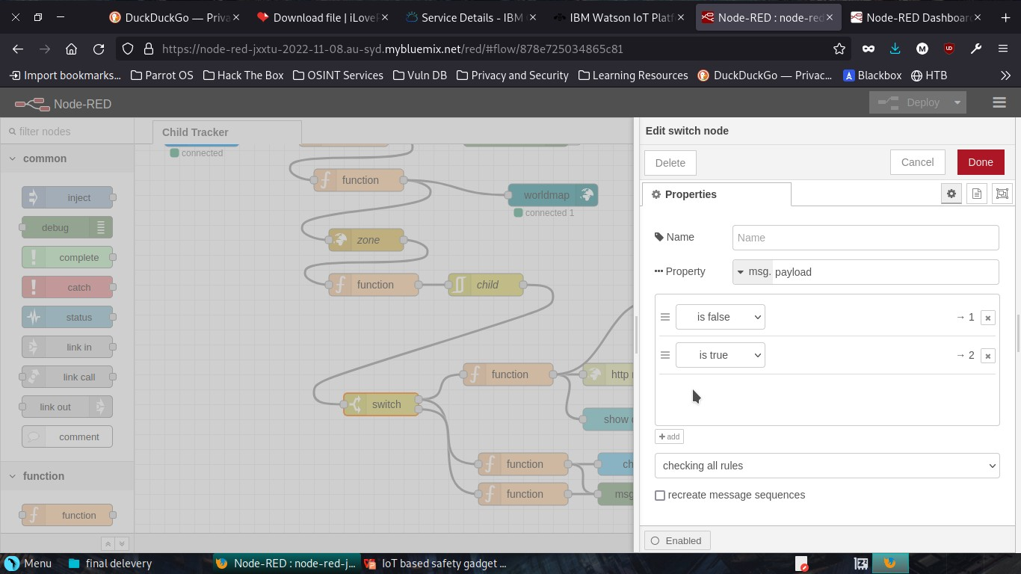

Slide 25
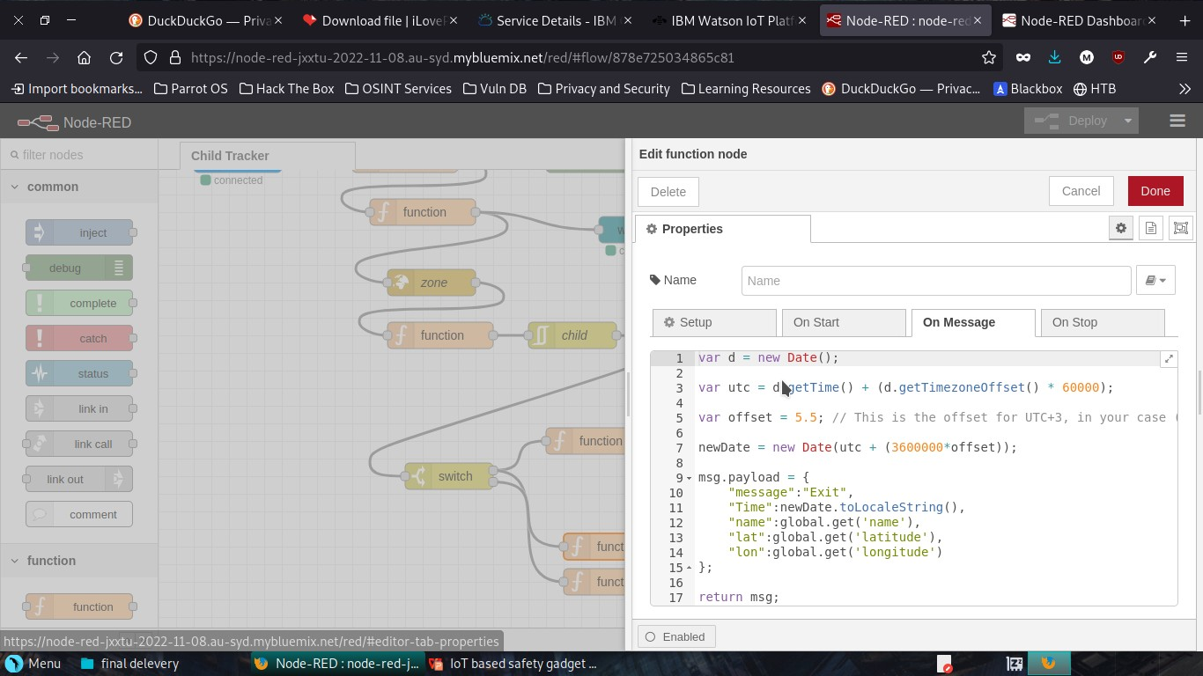

Slide 26
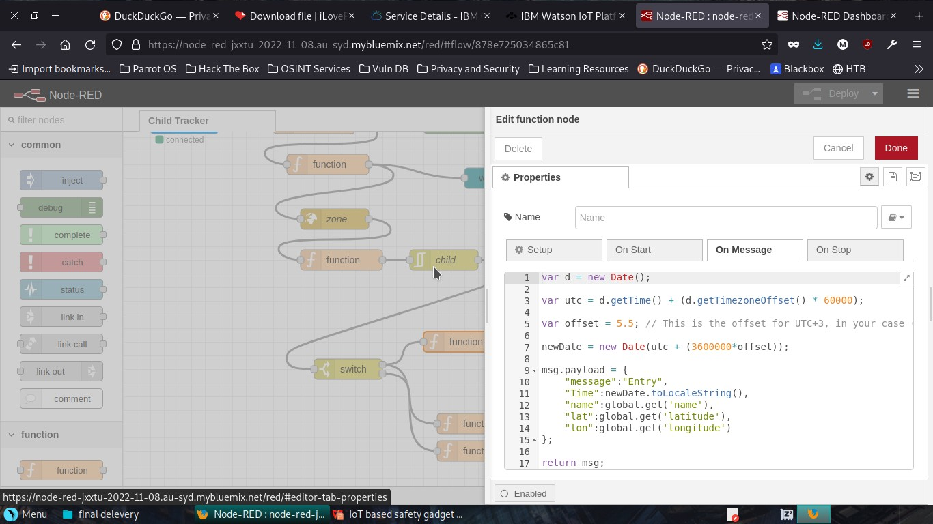

Slide 27
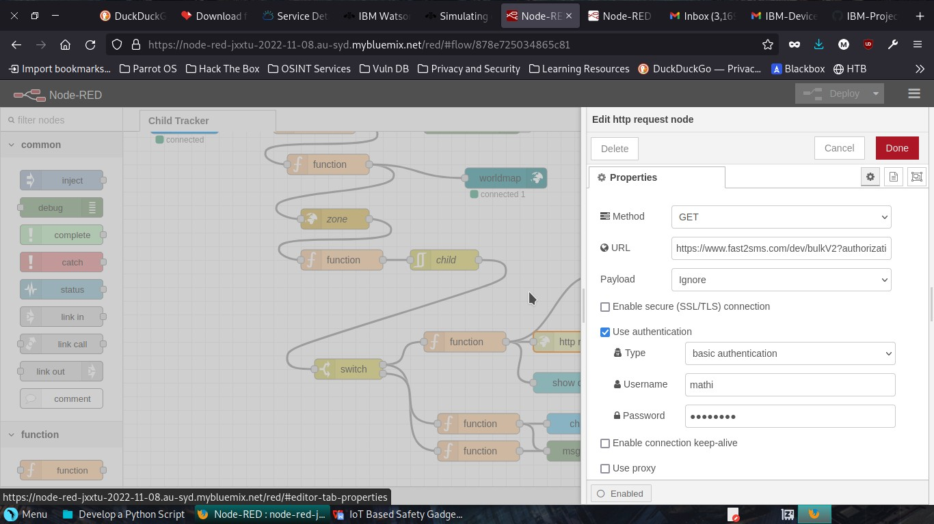

Slide 28
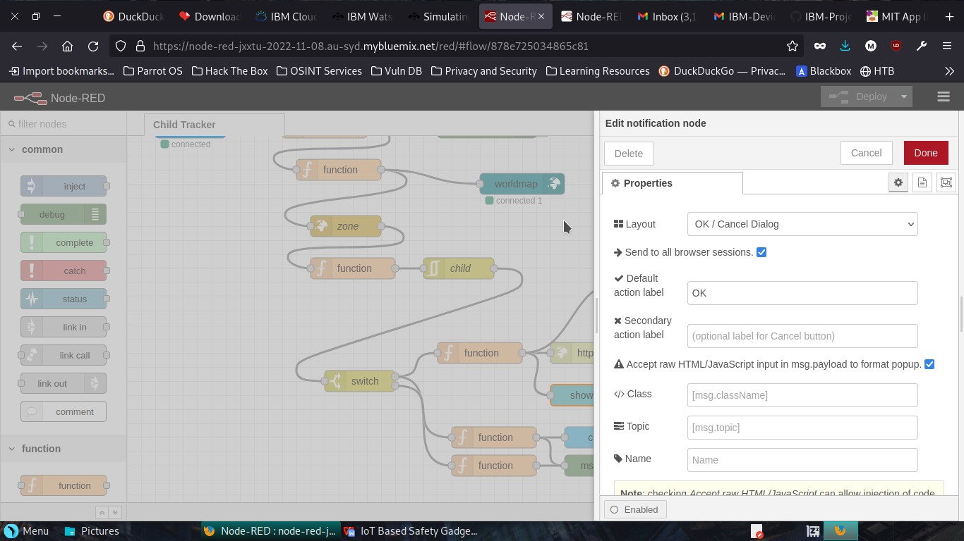

Slide 29
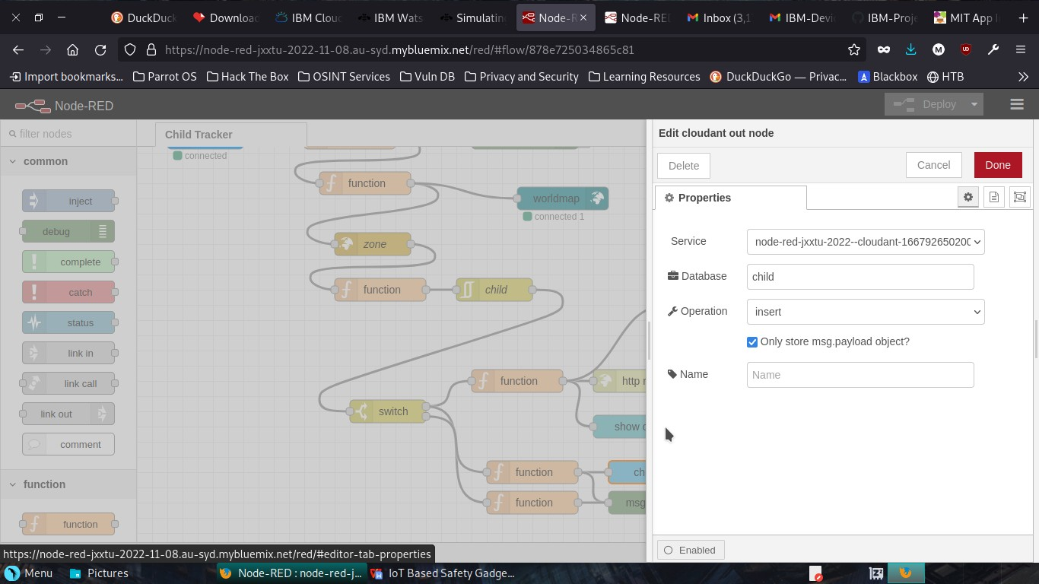

Slide 30
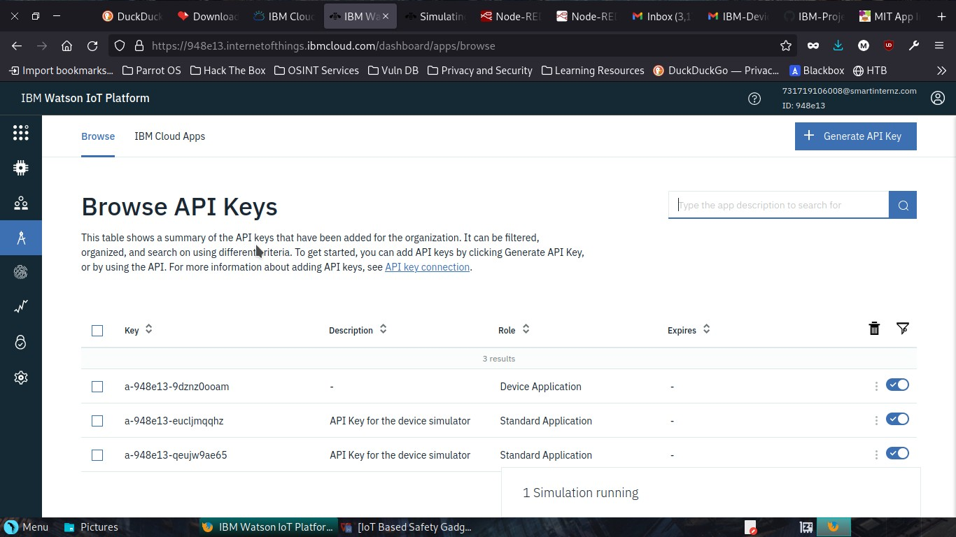
Connecting with IBM Cloud: Using IBM IOT node through the API key

Slide 31
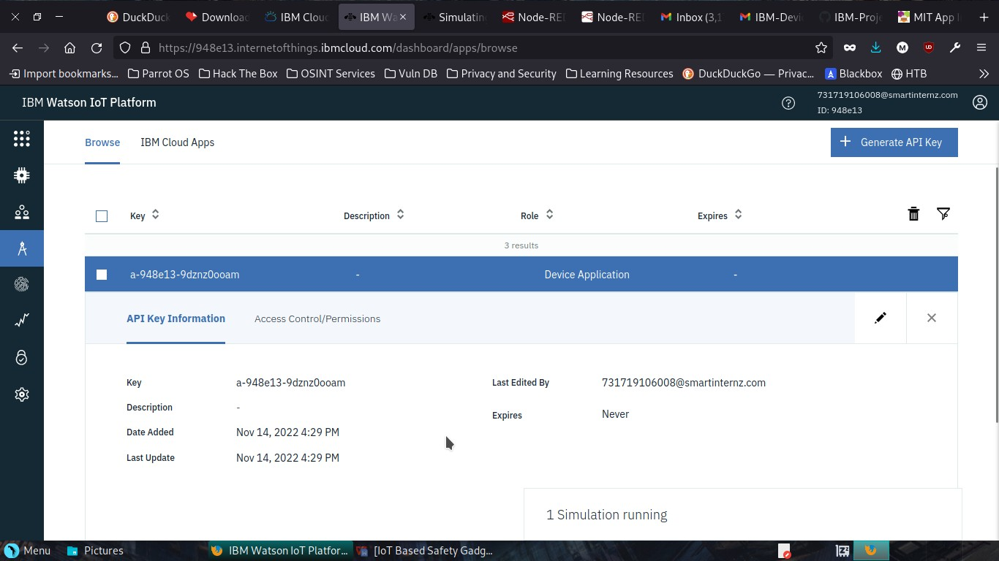

Slide 32
Transferring values from Python Code:

Slide 33
Node-Red:

Slide 34
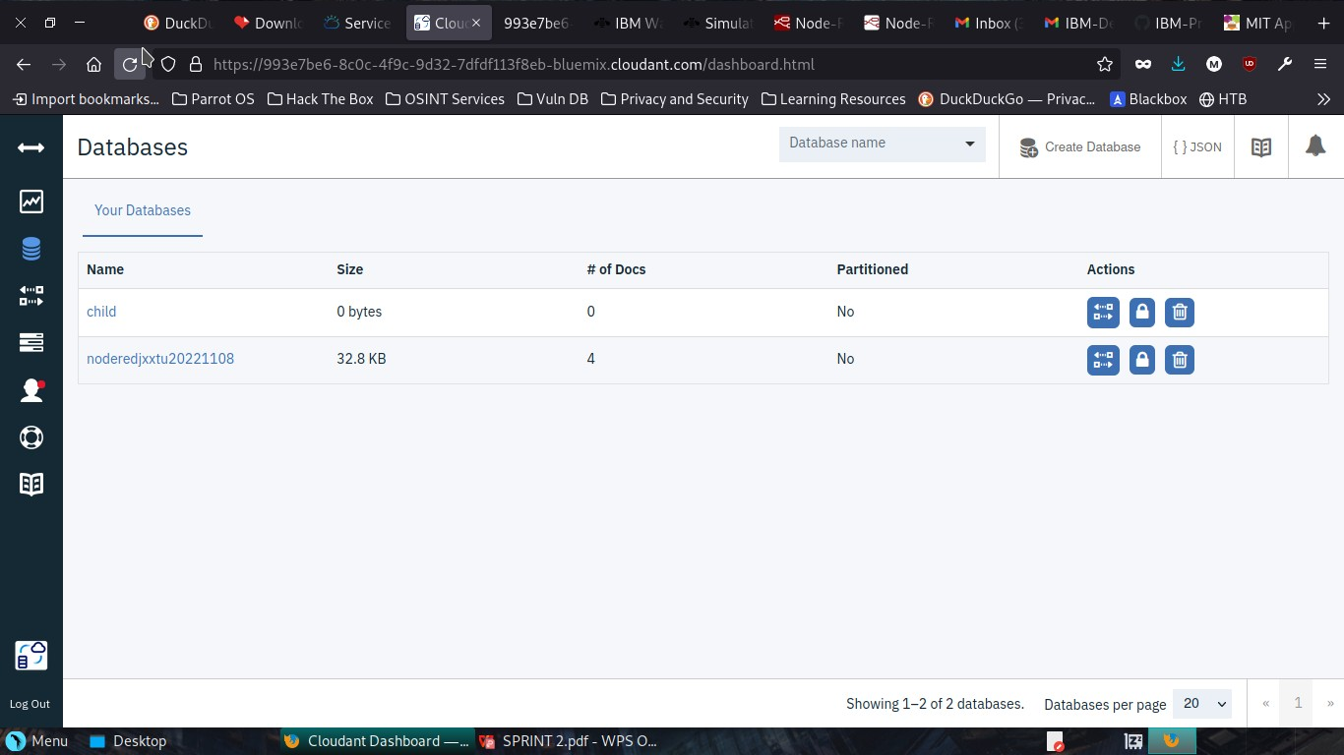
Creating Cloudant DB and integrating Node-Red with the Web UI

Slide 35
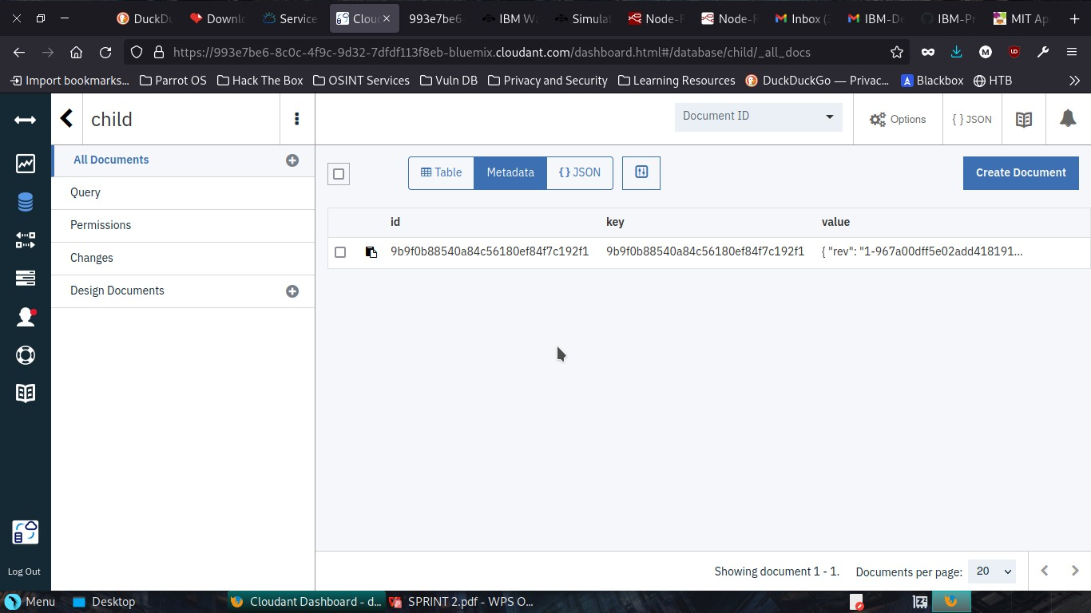

Slide 36
Node-Red Service with Cloudant Database:

Slide 38
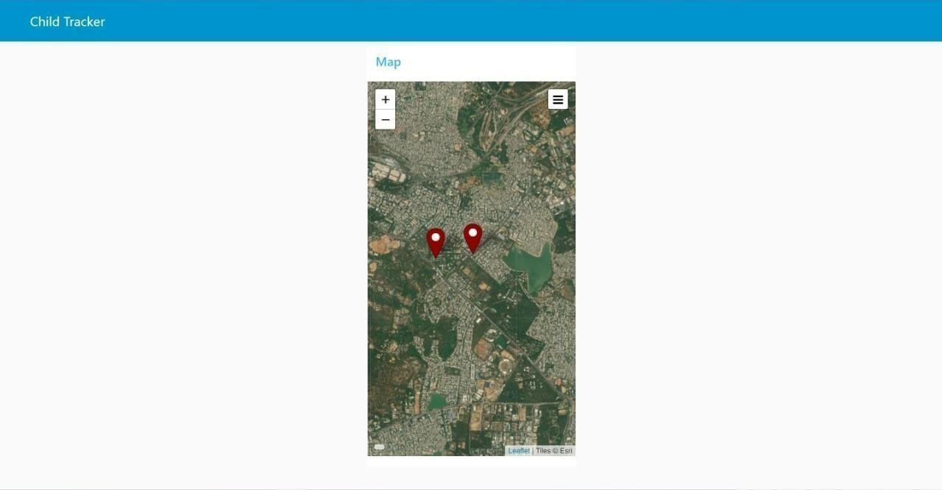
Node-Red Dashboard(Web ui):

Slide 39
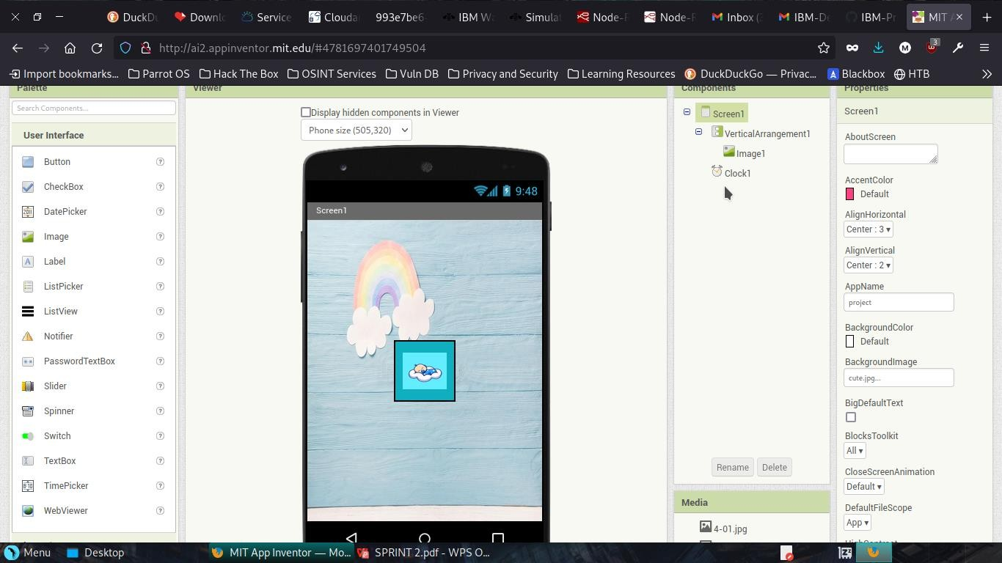
Creating the MIT app and Showing the child's location
Create App in MIT App inventor:

Slide 40
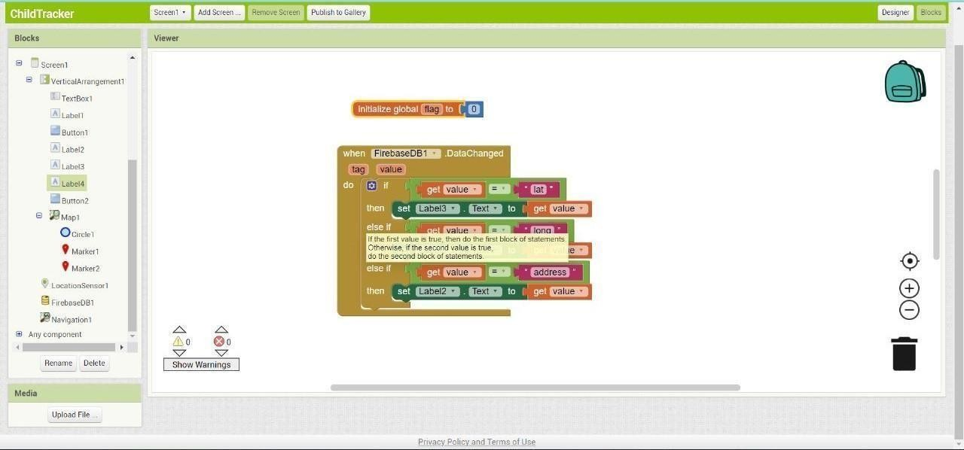
Block Configuration:

Slide 41
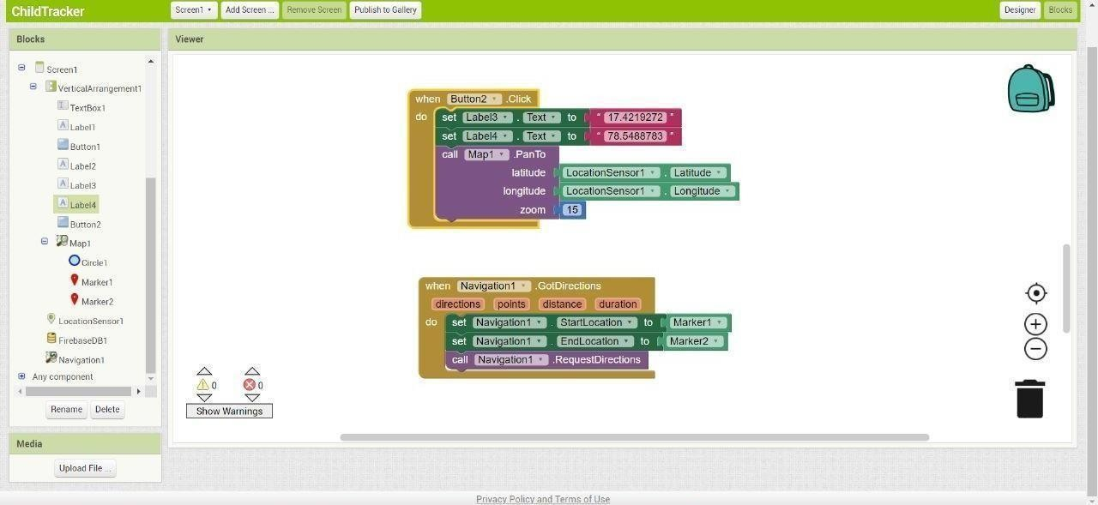

Slide 42
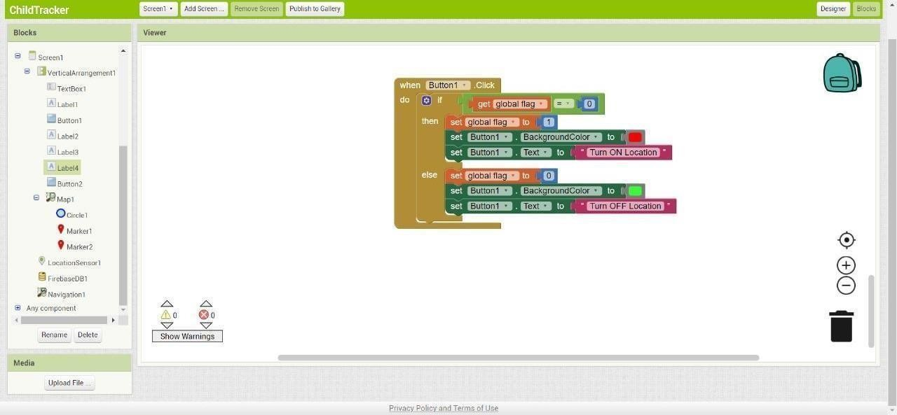

Slide 43
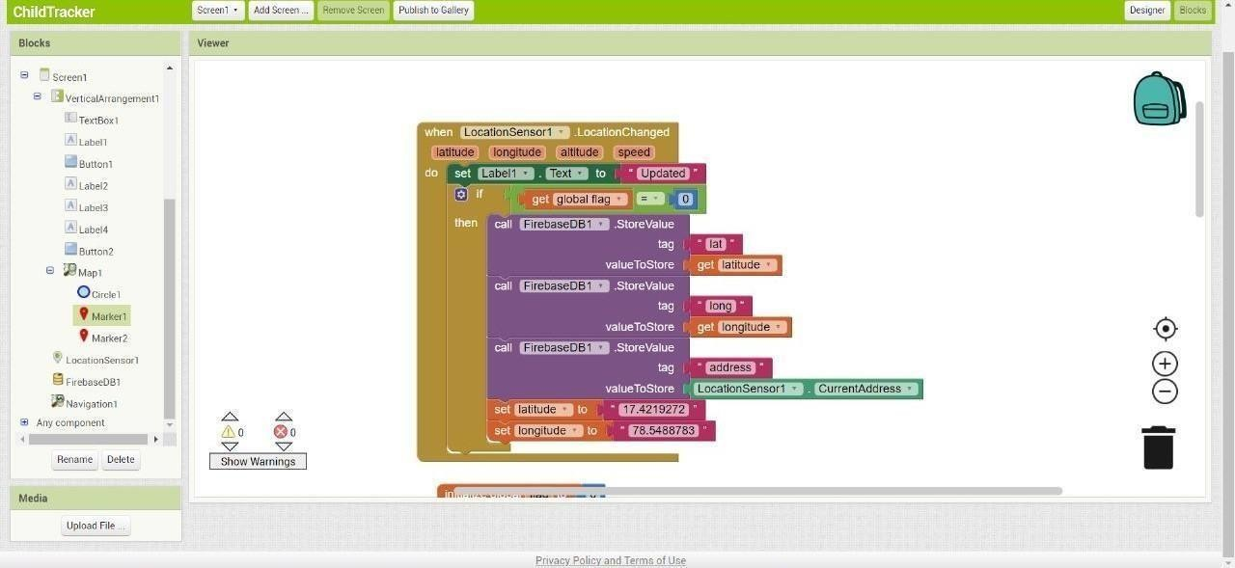

Slide 44
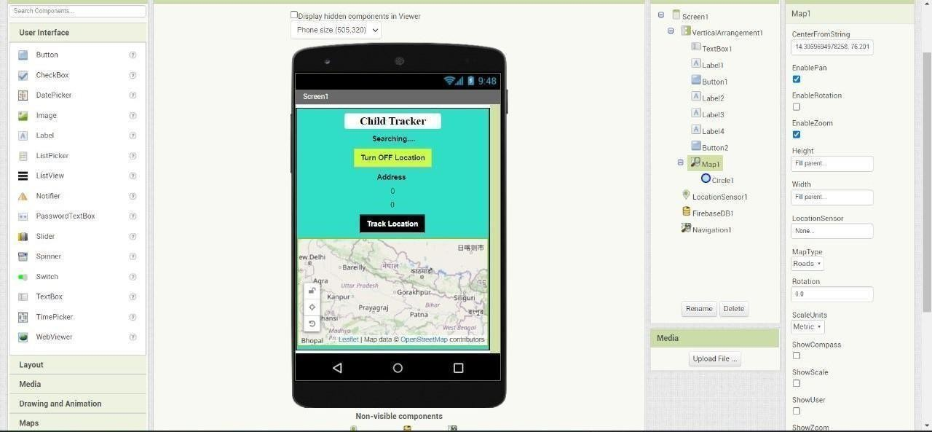
Output(App inventor):

Slide 45
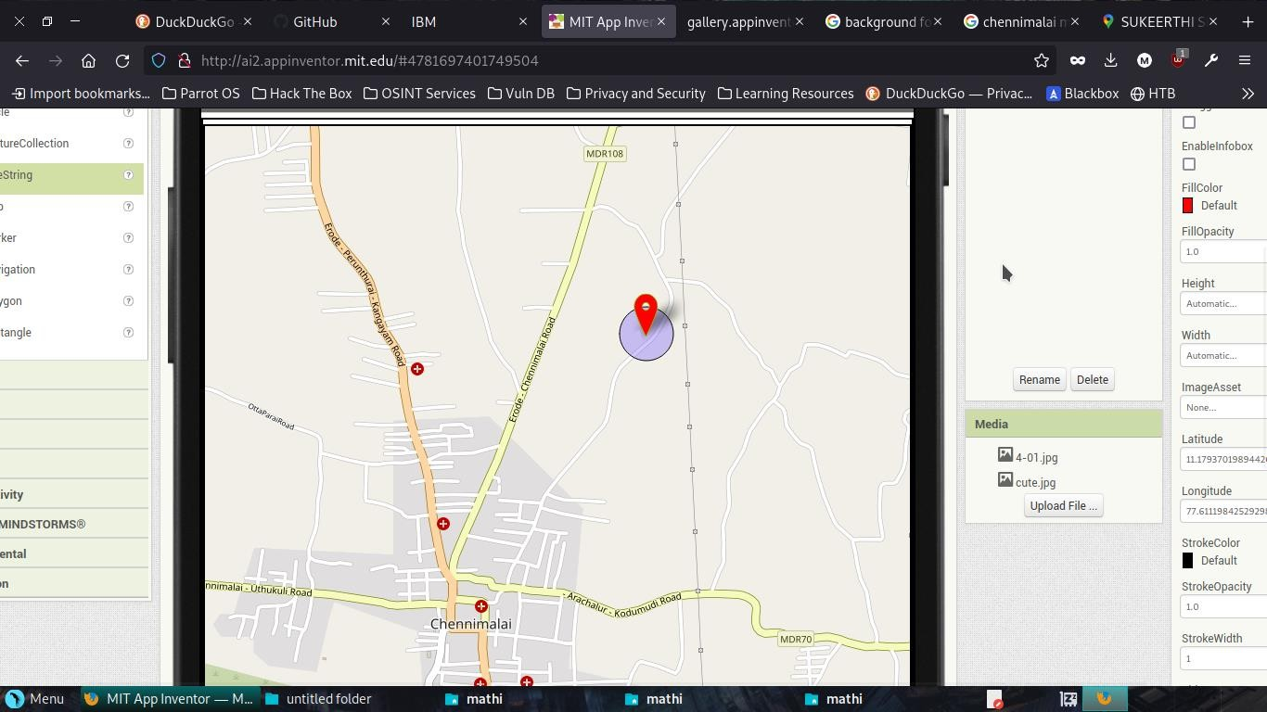
Location Status:

Slide 46
CONCLUSION
This paper to ensure the safety of children and increase their confidence.
Many experimenters are operating in this area and have formulated different technologies to aid children. The key represented in this paper takes the advantage of smartphones which proposes affluent elements like Google maps, SMS, etc. The child safety and protection device is proficient in acting as a smart IoT device. It equips parents with real-time location, the surrounding temperature, and along with an alarm buzzer for their child’s circumstances and the capability to locate their child. This paper depicts the fundamental design concept and functionality along with the anticipated consequences.

Slide 47
REFERENCES
{1} IDENTIFICATION OF CHILD HEALTH STATUS USING A INTELLIGENT SYSTEM
IEEE project work of ECEdepartment students.
{2} SAFETY OF A CHILD IN A LARGE PUBLIC
https://ieeexpl ore.ieee.org/abstract/document/9031524
{3} INTELLIGENT CHILD SAFETY SYSTEM USING MACHINE LEARNING IN IOT DEVICES.
https://ieeexpl ore.ieee.org/document/9277136
{4} SMAER WEARABLE DEVICES FOR LITTLE CHILDREN.
https://ieeexpl ore.ieee.org/document/7899531

